Slide 1

Mobile Robot Navigation with Artificial Intelligence (700.204, 21W)
Final project
AI for State Estimation
Supervision by:
Ass.-Prof. Dr. Jan Steinbrener
Hazem ibrahim

Slide 2
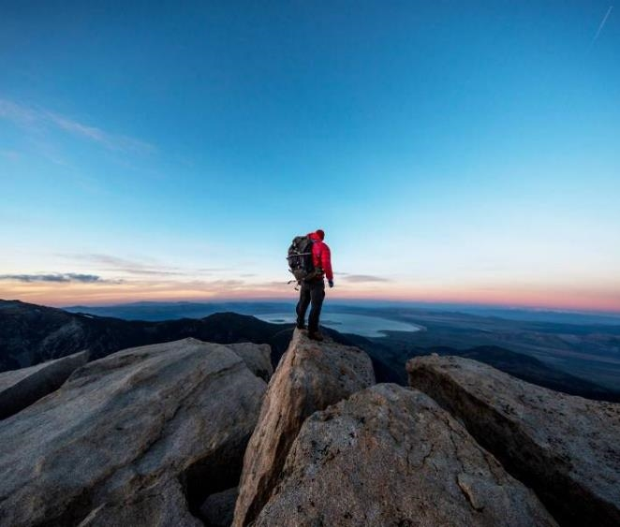

Content
IMU data collection using ROS
Neural network model architecture
Training and testing results
Trajectory evaluation

Slide 3

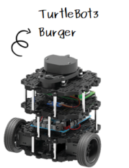
Introduction
Turtlebot3, the most popular open-source robot used for education and research, is used in data collection to an AI model for state estimation implementation.

Slide 4
IMU data collection using ROS
Turtlebot3 Gazebo Sim
Trajectories
IMU data is an input to our AI model.
Gazebo is used to simulate IMU data using Turtlebot3
Turtlebot3 moves in different trajectories (paths) while IMU data is being collected.
ROS bags collects the IMU data.
Open the Design Ideas pane for instant slide makeovers.
When we have design ideas, we’ll show them to you right there.
Mobile Robot Navigation with Artificial Intelligence (700.204, 21W)

Slide 5
Neural network model architecture
Turtlebot3 Gazebo Sim
Trajectories
IMU data is an input to our AI model.
Gazebo is used to simulate IMU data using Turtlebot3
Turtlebot3 moves in different trajectories (paths) while IMU data is being collected.
ROS bags collects the IMU data.
Open the Design Ideas pane for instant slide makeovers.
When we have design ideas, we’ll show them to you right there.
Mobile Robot Navigation with Artificial Intelligence (700.204, 21W)

Slide 6

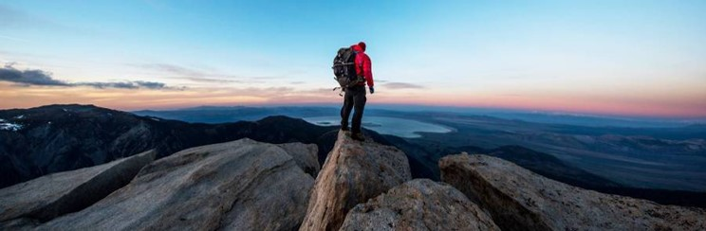

Topic one
Subtitle

Slide 7
Chart

Slide 8
Table
 | Category 1 | Category 2 | Category 3 | Category 4
Item 1 | 4.5 | 2.3 | 1.7 | 5.0
Item 2 | 3.2 | 5.1 | 4.4 | 3.0
Item 3 | 2.1 | 1.7 | 2.5 | 2.8
Item 4 | 4.5 | 2.2 | 1.7 | 7.0

Slide 9
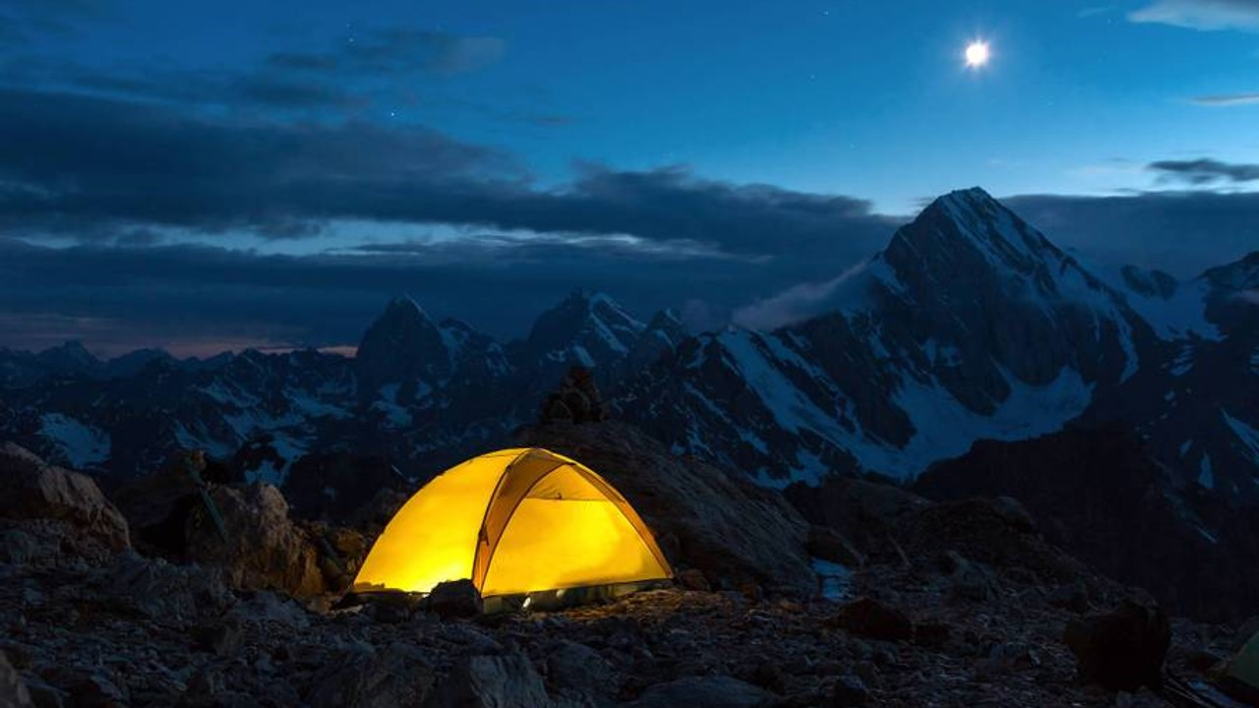
The way to get started is to quit talking and begin doing.
Walt Disney

Slide 10
Team
Name Title
Name Title
Name Title
Name Title

Slide 11
Timeline
Title
To start a presentation, go to the Slide Show tab, and select From Beginning.
Title
To display Presenter view, in Slide Show view, on the control bar at the bottom left select the three dots, and then Show Presenter View.
Title
During your presentation, the speaker notes are visible on your monitor, but aren't visible to the audience.
Title
The Notes pane is a box that appears below each slide. Tap it to add notes.
Title
If you don’t see the Notes pane or it is completely minimized, click Notes on the task bar across the bottom of the PowerPoint window.

Slide 12
Additional content
Subtitle
Subtitle
Subtitle
Add text, images, art, and videos.
Add transitions, animations, and motion.
Save to OneDrive, to get to your presentations from your computer, tablet, or phone.
This PowerPoint theme uses its own unique set of colors, fonts, and effects to create the overall look and feel of these slides.
PowerPoint has tons of themes to give your presentation just the right personality.
Open the Design Ideas pane for instant slide makeovers.
When we have design ideas, we’ll show them to you right there.

Slide 13
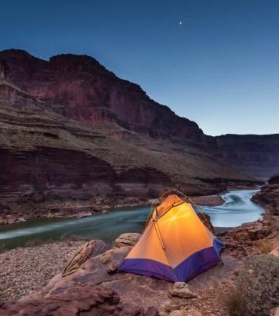

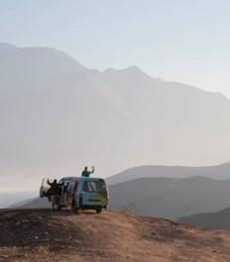
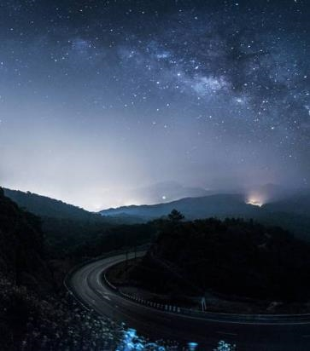
Summary
With PowerPoint, you can create presentations and share your work with others, wherever they are. Type the text you want here to get started. You can also add images, art, and videos on this template. Save to OneDrive and access your presentations from your computer, tablet, or phone.

Slide 14


Thank you
Presenter name
Email address
Website

